Slide 1

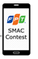
System Architecture

Slide 2
System Architecture
1a. Text Search

Slide 3

System Architecture
1b. Voice Search
1a. Text Search

Slide 4
System Architecture
1b. Voice Search
1c. Text
1a. Text Search

Slide 5


System Architecture
Google Map API
1b. Voice Search
1c. Text
Bus Service
1a. Text Search

Slide 6
System Architecture
Google Map API
1b. Voice Search
1c. Text
2. Request motor or bus route
Bus Service
1a. Text Search

Slide 7
System Architecture
Google Map API
1b. Voice Search
1c. Text
2. Request motor or bus route
Bus Service
3. List results
1a. Text Search

Slide 8
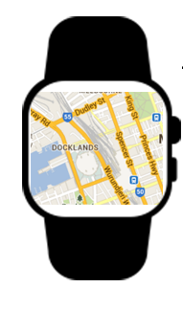
System Architecture
Google Map API
1b. Voice Search
1c. Text
2. Request motor or bus route
Bus Service
3. List results
1a. Text Search
Android Wear

Slide 9
System Architecture
Google Map API
1b. Voice Search
1c. Text
2. Request motor or bus route
Bus Service
3. List results
1a. Text Search
3. Sync data when on street
Android Wear

Slide 10

System Architecture
Google Map API
1b. Voice Search
1c. Text
2. Request motor or bus route
Bus Service
3. List results
1a. Text Search
3. Sync data when on street
Android Wear
Text To Speech API

Slide 11
System Architecture
Google Map API
1b. Voice Search
1c. Text
2. Request motor or bus route
Bus Service
3. List results
1a. Text Search
3. Sync data when on street
4. Request sound files
Android Wear
Text To Speech API

Slide 12
System Architecture
Google Map API
1b. Voice Search
1c. Text
2. Request motor or bus route
Bus Service
3. List results
1a. Text Search
3. Sync data when on street
5. Sound files
4. Request sound files
Android Wear
Text To Speech API

